Slide 1
Announcements
Midterm: Wednesday 7pm-9pm
See midterm prep page (posted on Piazza, inst.eecs page)
Four rooms; your room determined by last two digits of your SID:
00-32: Dwinelle 155
33-45: Genetics and Plant Biology 100
46-62: Hearst Annex A1
63-99: Pimentel 1
Discussions this week by topic
Survey: complete it before midterm; 80% participation = +1pt

Slide 2

Bayes net global semantics
Bayes nets encode joint distributions as product of conditional distributions on each variable:
P(X₁,..,X_{n}) = ∏_{i} P(X_{i} | Parents(X_{i}))

Slide 3
Conditional independence semantics
Every variable is conditionally independent of its non-descendants given its parents
Conditional independence semantics <=> global semantics

Slide 4
Example
V-structure
JohnCalls independent of Burglary given Alarm?
Yes
JohnCalls independent of MaryCalls given Alarm?
Yes
Burglary independent of Earthquake?
Yes
Burglary independent of Earthquake given Alarm?
NO!
Given that the alarm has sounded, both burglary and earthquake become more likely
But if we then learn that a burglary has happened, the alarm is explained away and the probability of earthquake drops back
Burglary
Earthquake
Alarm
John calls
Mary calls

Slide 5
Markov blanket
A variable’s Markov blanket consists of parents, children, children’s other parents
Every variable is conditionally independent of all other variables given its Markov blanket

Slide 6
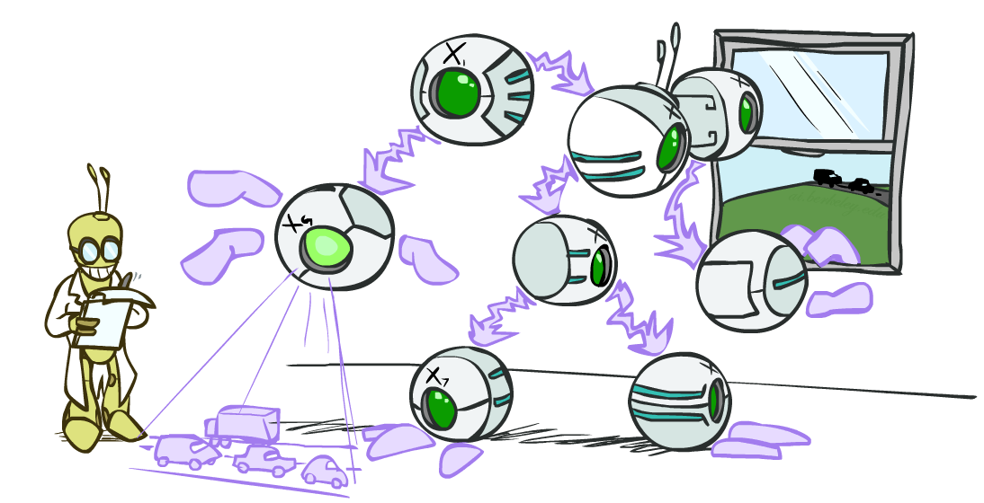
CS 188: Artificial Intelligence
Bayes Nets: Exact Inference
Instructor: Sergey Levine and Stuart Russell--- University of California, Berkeley
Notes:
Please retain proper attribution, including the reference to ai.berkeley.edu. Thanks!

Slide 7

Bayes Nets
Part I: Representation
Part II: Exact inference
Enumeration (always exponential complexity)
Variable elimination (worst-case exponential complexity, often better)
Inference is NP-hard in general
Part III: Approximate Inference
Later: Learning Bayes nets from data

Slide 8

Inference
Inference: calculating some useful quantity from a probability model (joint probability distribution)
Examples:
Posterior marginal probability
P(Q|e₁,..,e_{k})
E.g., what disease might I have?
Most likely explanation:
argmax_{q,r,s} P(Q=q,R=r,S=s|e₁,..,e_{k})
E.g., what did he say?

Slide 9
Inference by Enumeration in Bayes Net
Reminder of inference by enumeration:
Any probability of interest can be computed by summing entries from the joint distribution
Entries from the joint distribution can be obtained from a BN by multiplying the corresponding conditional probabilities
P(B | j, m) = α P(B, j, m)
= α ∑_{e,a} P(B, e, a, j, m)
= α ∑_{e,a} P(B) P(e) P(a|B,e) P(j|a) P(m|a)
So inference in Bayes nets means computing sums of products of numbers: sounds easy!!
Problem: sums of exponentially many products!
B
E
A
J
M

Slide 10
Can we do better?
Consider uwy + uwz + uxy + uxz + vwy + vwz + vxy +vxz
16 multiplies, 7 adds
Lots of repeated subexpressions!
Rewrite as (u+v)(w+x)(y+z)
2 multiplies, 3 adds
∑_{e,a} P(B) P(e) P(a|B,e) P(j|a) P(m|a)
= P(B)P(e)P(a|B,e)P(j|a)P(m|a) + P(B)P(¬e)P(a|B,¬e)P(j|a)P(m|a)
+ P(B)P(e)P(¬a|B,e)P(j|¬a)P(m|¬a) + P(B)P(¬e)P(¬a|B,¬e)P(j|¬a)P(m|¬a)
Lots of repeated subexpressions!

Slide 11
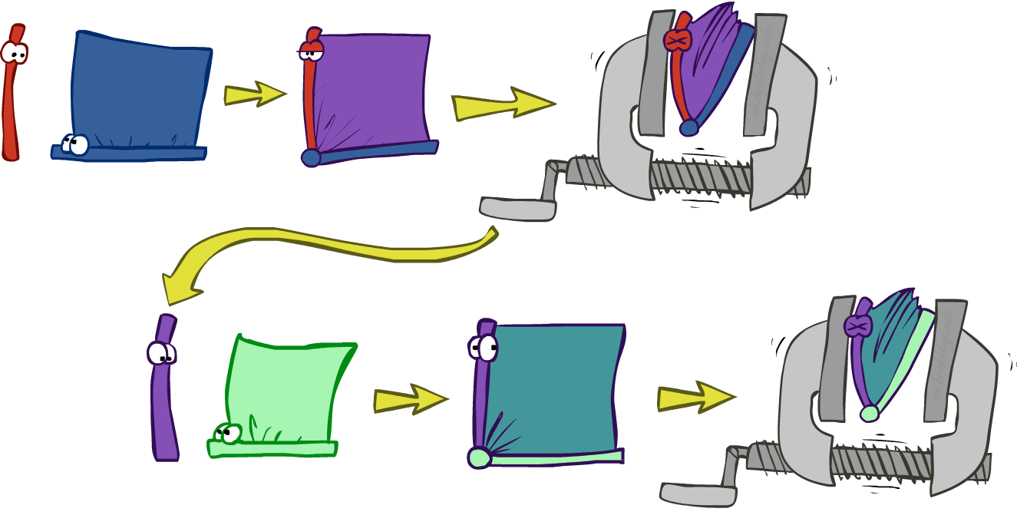
Variable elimination: The basic ideas
Move summations inwards as far as possible
P(B | j, m) = α ∑_{e,a} P(B) P(e) P(a|B,e) P(j|a) P(m|a)
= α P(B) ∑_{e} P(e) ∑_{a} P(a|B,e) P(j|a) P(m|a)
Do the calculation from the inside out
I.e., sum over a first, then sum over e
Problem: P(a|B,e) isn’t a single number, it’s a bunch of different numbers depending on the values of B and e
Solution: use arrays of numbers (of various dimensions) with appropriate operations on them; these are called factors

Slide 12
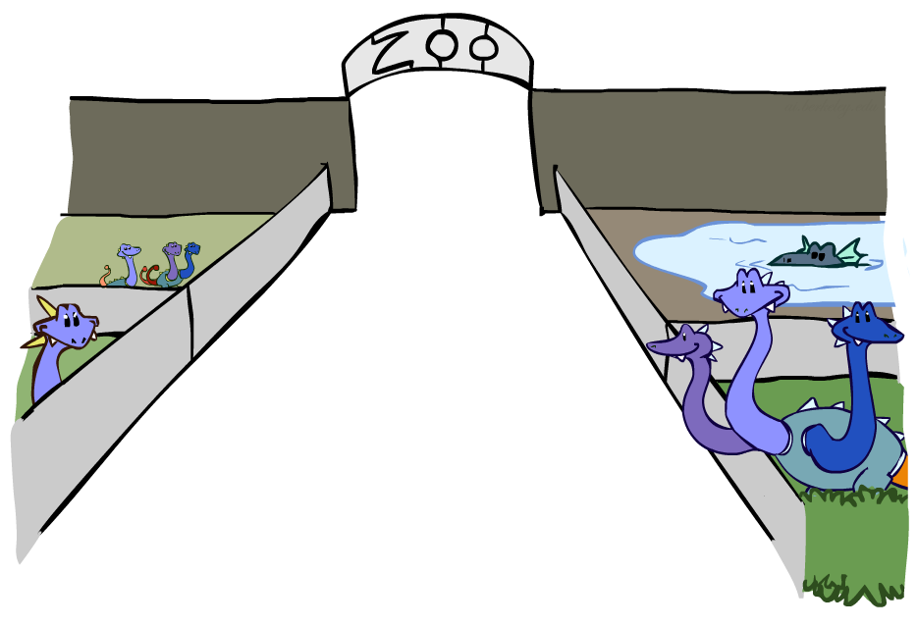
Factor Zoo

Slide 13

Factor Zoo I
Joint distribution: P(X,Y)
Entries P(x,y) for all x, y
|X|x|Y| matrix
Sums to 1
Projected joint: P(x,Y)
A slice of the joint distribution
Entries P(x,y) for one x, all y
|Y|-element vector
Sums to P(x)
P(A,J)
A \ J | true | false
true | 0.09 | 0.01
false | 0.045 | 0.855
P(a,J)
A \ J | true | false
true | 0.09 | 0.01
Number of variables (capitals) = dimensionality of the table

Slide 14
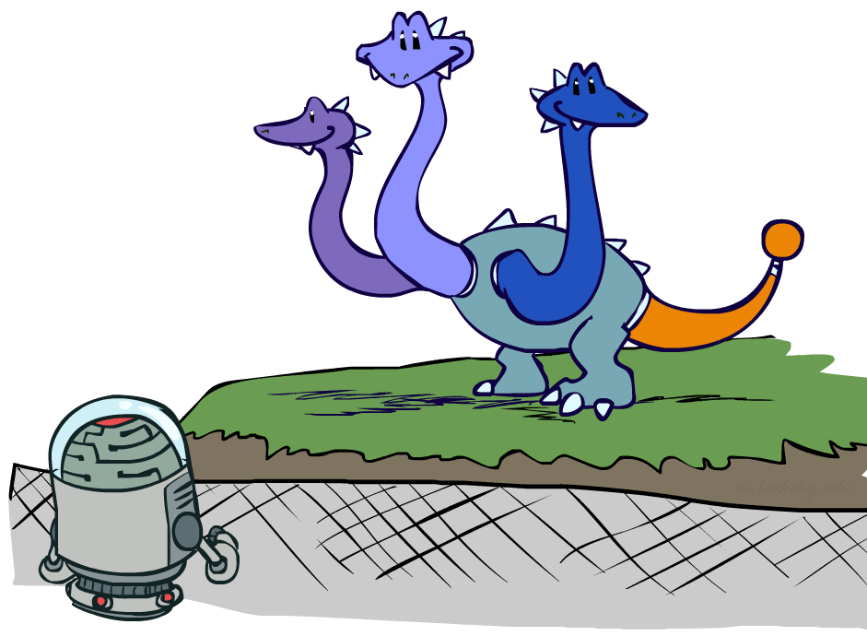
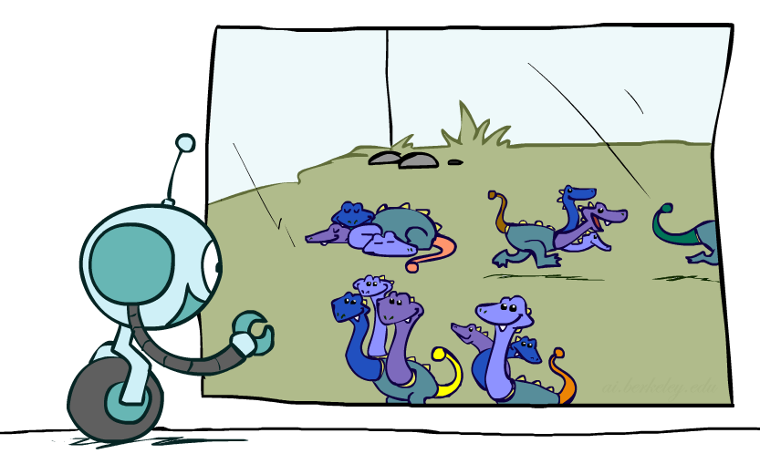
Factor Zoo II
P(J|a)
Single conditional: P(Y | x)
Entries P(y | x) for fixed x, all y
Sums to 1
Family of conditionals:
P(X |Y)
Multiple conditionals
Entries P(x | y) for all x, y
Sums to |Y|
A \ J | true | false
true | 0.9 | 0.1
P(J|A)
A \ J | true | false
true | 0.9 | 0.1
false | 0.05 | 0.95
} - P(J|a)
} - P(J|¬a)

Slide 15

Operation 1: Pointwise product
First basic operation: pointwise product of factors (similar to a database join, not matrix multiply!)
New factor has union of variables of the two original factors
Each entry is the product of the corresponding entries from the original factors
Example: P(J|A) x P(A) = P(A,J)
P(J|A)
P(A,J)
P(A)
A \ J | true | false
true | 0.9 | 0.1
false | 0.05 | 0.95
A \ J | true | false
true | 0.09 | 0.01
false | 0.045 | 0.855
true | 0.1
false | 0.9
x
=

Slide 16
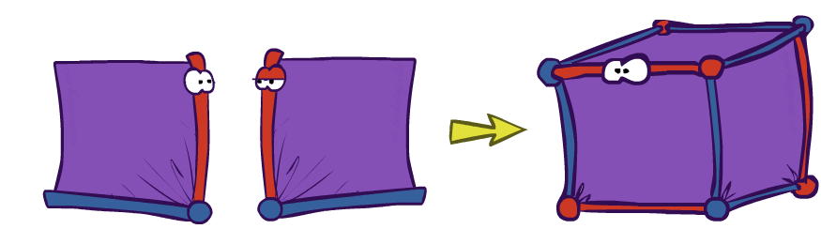
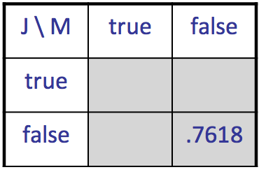
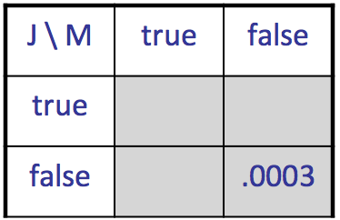
Example: Making larger factors
Example: P(A,J) x P(A,M) = P(A,J,M)
P(A,J,M)
P(A,J)
P(A,M)
A \ J | true | false
true | 0.09 | 0.01
false | 0.045 | 0.855
A \ M | true | false
true | 0.07 | 0.03
false | 0.009 | 0.891
x
=
A=false
A=true

Slide 17
Example: Making larger factors
Example: P(U,V) x P(V,W) x P(W,X) = P(U,V,W,X)
Sizes: [10,10] x [10,10] x [10,10] = [10,10,10,10]
I.e., 300 numbers blows up to 10,000 numbers!
Factor blowup can make VE very expensive

Slide 18
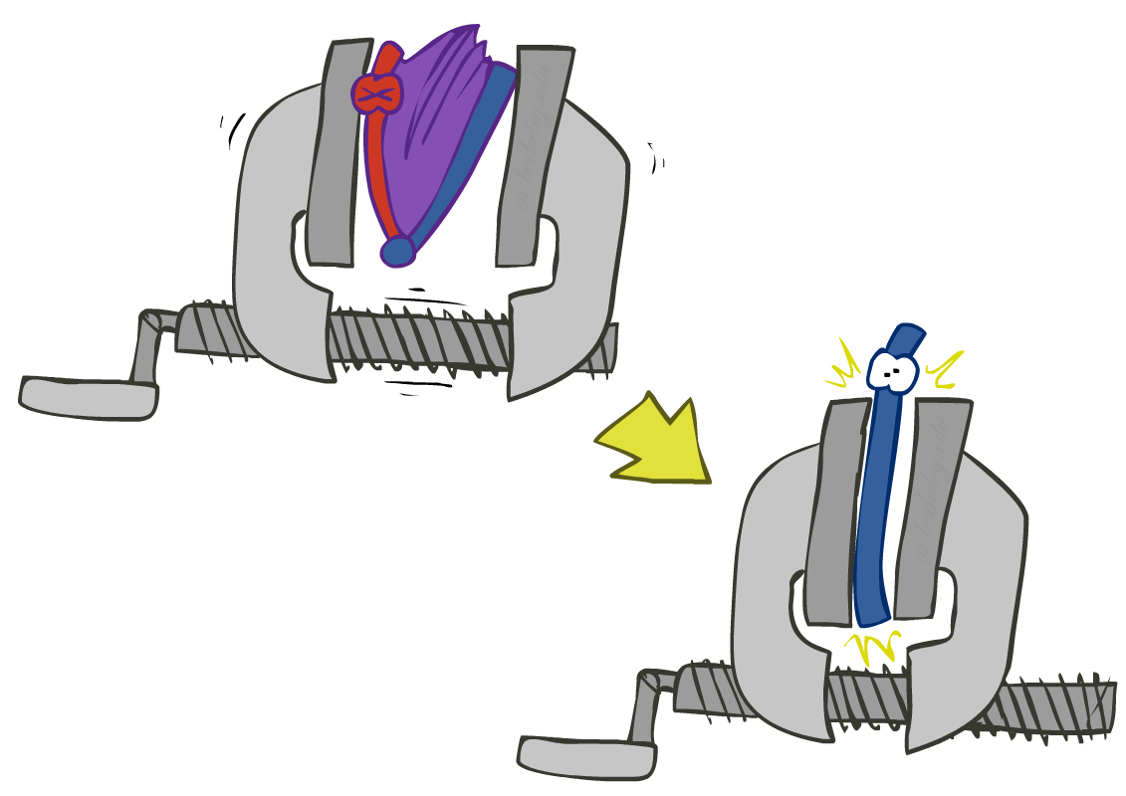
Operation 2: Summing out a variable
Second basic operation: summing out (or eliminating) a variable from a factor
Shrinks a factor to a smaller one
Example: ∑_{j} P(A,J) = P(A,j) + P(A,¬j) = P(A)
P(A,J)
P(A)
A \ J | true | false
true | 0.09 | 0.01
false | 0.045 | 0.855
Sum out J
true | 0.1
false | 0.9

Slide 19
Summing out from a product of factors
Project the factors each way first, then sum the products
Example: ∑_{a} P(a|B,e) x P(j|a) x P(m|a)
= P(a|B,e) x P(j|a) x P(m|a) +
P(¬a|B,e) x P(j|¬a) x P(m|¬a)

Slide 20

Variable Elimination

Slide 21
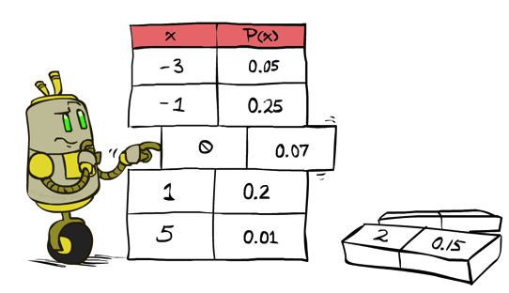
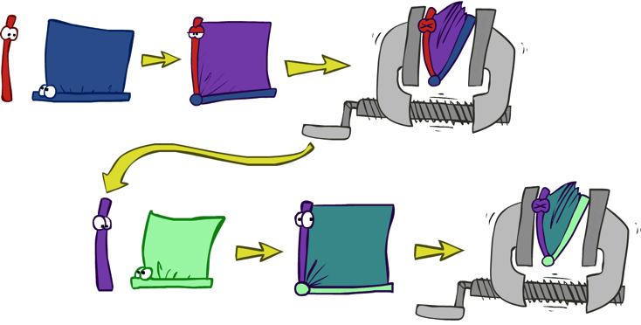


Variable Elimination
Query: P(Q|E₁=e₁,.., E_{k}=e_{k})
Start with initial factors:
Local CPTs (but instantiated by evidence)
While there are still hidden variables (not Q or evidence):
Pick a hidden variable H
Join all factors mentioning H
Eliminate (sum out) H
Join all remaining factors and normalize

Slide 22
Variable Elimination
function VariableElimination(Q , e, bn) returns a distribution over Q
factors ← [ ]
for each var in ORDER(bn.vars) do
factors ← [MAKE-FACTOR(var, e)|factors]
if var is a hidden variable then
factors ← SUM-OUT(var,factors)
return NORMALIZE(POINTWISE-PRODUCT(factors))

Slide 23
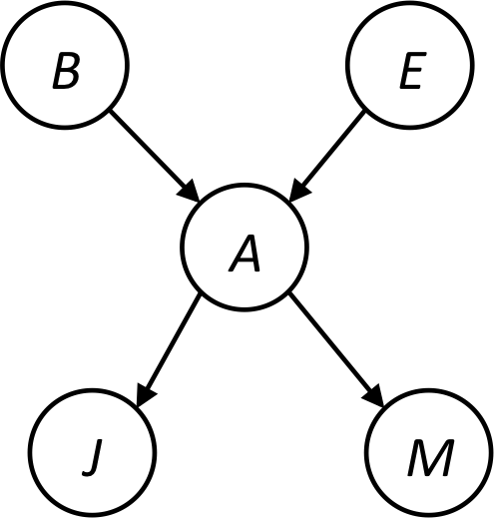


Example
Query P(B | j,m)
P(B) P(E) P(A|B,E) P(j|A) P(m|A)
Choose A
P(A|B,E)
P(j|A)
P(m|A)
P(j,m|B,E)
P(B) P(E) P(j,m|B,E)

Slide 24
Example
P(B) P(E) P(j,m|B,E)
Choose E
P(E)
P(j,m|B,E)
P(j,m|B)
P(B) P(j,m|B)
Finish with B
P(B)
P(j,m|B)
P(j,m,B)
Normalize
P(B | j,m)

Slide 25
Order matters
Z
Order the terms Z, A, B C, D
P(D) = α ∑_{z,a,b,c} P(z) P(a|z) P(b|z) P(c|z) P(D|z)
= α ∑_{z} P(z) ∑_{a} P(a|z) ∑_{b} P(b|z) ∑_{c} P(c|z) P(D|z)
Largest factor has 2 variables (D,Z)
Order the terms A, B C, D, Z
P(D) = α ∑_{a,b,c,z} P(a|z) P(b|z) P(c|z) P(D|z) P(z)
= α ∑_{a} ∑_{b} ∑_{c} ∑_{z} P(a|z) P(b|z) P(c|z) P(D|z) P(z)
Largest factor has 4 variables (A,B,C,D)
In general, with n leaves, factor of size 2^{n}
A
B
C
D

Slide 26
VE: Computational and Space Complexity
The computational and space complexity of variable elimination is determined by the largest factor (and it’s space that kills you)
The elimination ordering can greatly affect the size of the largest factor.
E.g., previous slide’s example 2^{n} vs. 2
Does there always exist an ordering that only results in small factors?
No!

Slide 27
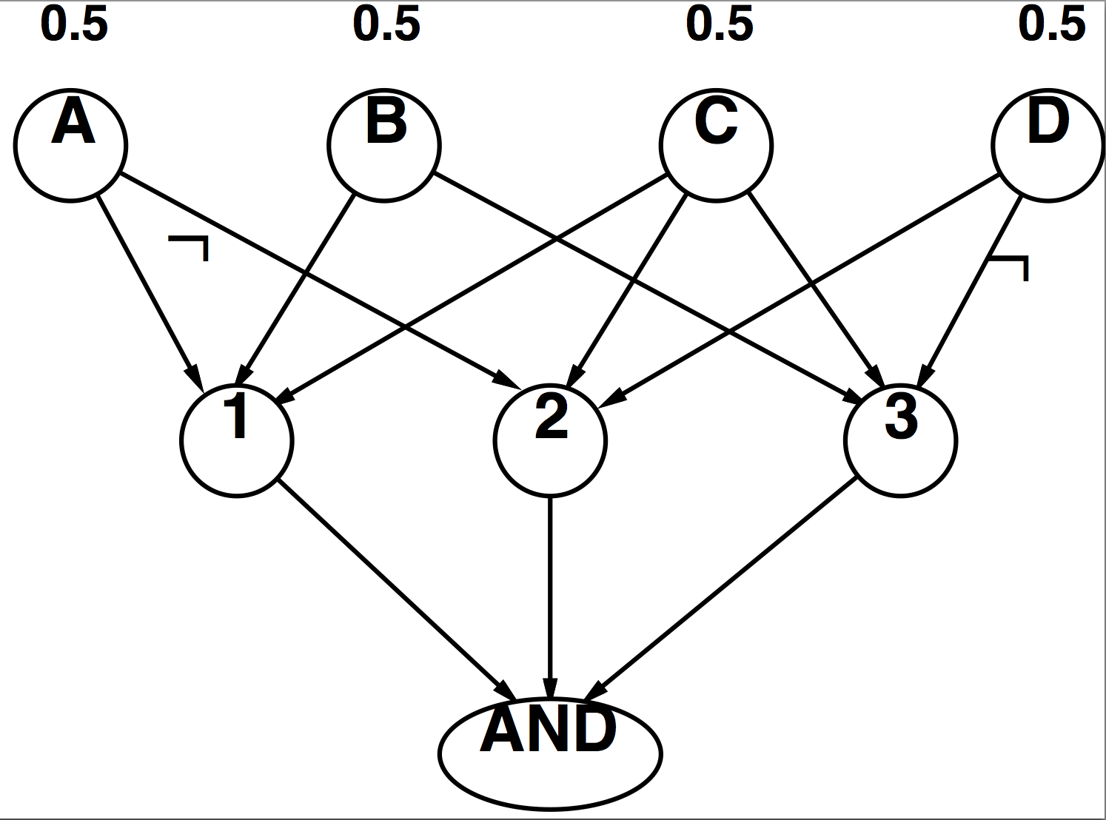
Worst Case Complexity? Reduction from SAT
CNF clauses:
A v B v C
C v D v ¬A
B v C v ¬D
P(AND) > 0 iff clauses are satisfiable
=> NP-hard
P(AND) = S x 0.5^{n} where S is the number of satisfying assignments for clauses
=> #P-hard
Notes:
Make this model simpler (no reason for fan-in constraint)

Slide 28
Polytrees
A polytree is a directed graph with no undirected cycles
For poly-trees the complexity of variable elimination is linear in the network size if you eliminate from the leave towards the roots
This is essentially the same theorem as for tree-structured CSPs

Slide 29
Bayes Nets
Part I: Representation
Part II: Exact inference
Enumeration (always exponential complexity)
Variable elimination (worst-case exponential complexity, often better)
Inference is NP-hard in general
Part III: Approximate Inference
Later: Learning Bayes nets from data

